Slide 1
CENTERSTONE CLINICAL TRAINING SERIES
Prevention Pathway Overview
Suicide Prevention · Violence Risk · Assessment · Intervention
School-Based Therapist Training
June 2026

Slide 2
PUTTING IT INTO PRACTICE
Welcome to Today's Training
Prevention Pathway Overview
Suicide prevention and violence risk are among the highest-stakes areas of our clinical work. This training is about building real confidence — not just familiarity. You will leave today having scored assessments, interpreted results, and practiced making enrollment decisions alongside a colleague.
Objectives — By the end of this training you will be able to:
This training includes direct instruction, live walkthroughs of each assessment, structured pair role plays with scoring and interpretation, and a group discussion on clinical enrollment decisions.
01
Identify the three clinical pathways and know when each is triggered.
02
Administer, score, and interpret the PHQ-A, C-SSRS, and RROVS correctly.
03
Apply the enrollment and disenrollment criteria for each pathway with clinical confidence.
04
Use the Stanley-Brown Safety Plan, Safety Sweep, and CALM in practice.
05
Describe the RELATE model and its role in suicide-specific care.
June 2026 · School-Based Therapist Training

Slide 3
Why This Training Matters
"
01
Centerstone's Zero Suicide Initiative began with a charge from our CEO to develop a clinical pathway for suicide prevention — not because the work wasn't happening, but because we wanted to make sure it was happening consistently, systematically, and in a way that gave every client the best possible chance at safety and recovery.
02
These pathways exist so that no one slips through the cracks. They give you a shared language with your team, a clear structure when things feel uncertain, and documentation that protects both you and your client.
03
This training is not about checking a box. It is about building the kind of clinical confidence that lets you stay calm and present with a client in their most vulnerable moments.
Every assessment you complete is an act of care. Every safety plan is a lifeline. Do this work with that in mind.

Slide 4
Three Pathways. One Goal: Safety.
Each pathway is triggered by a specific screen, requires a specific assessment, and has specific treatment and disenrollment criteria.
Urgent Risk Pathway
Moderate Risk Pathway
Violence Risk Pathway
⬥ TRIGGERED BY
⬥ TRIGGERED BY
⬥ TRIGGERED BY
PHQ-9 Item 9 positive, recent suicide attempt, or recent psychiatric hospitalization.
PHQ-9 Item 9 negative BUT INQ-FAD3 screener (3 questions) is positive.
Positive RROVS (Rapid Risk of Violence Screener). Screened at intake and every 6 months.
⬥ ASSESSMENT
⬥ ASSESSMENT
⬥ RESPONSE REQUIRED
C-SSRS Lifetime/Recent at intake; C-SSRS Since Last Visit at each subsequent session.
Full INQ-FAD3 (16 questions) measuring burdensomeness, belongingness, and fearlessness about death.
Within 1 week: Structural Clinical Risk form + Support Crisis Plan. Not optional.
⬥ FREQUENCY
⬥ SCOPE
Weekly sessions + weekly staffing.
⬥ FREQUENCY
Separate but equally critical track. Protects others — not just the client.
Bi-weekly sessions. Monitor for escalation to Urgent Risk at every session.
Highest-Level Response
Intake + Every 6 Months
Catches What PHQ-9 Misses
Your clinical judgment is always part of the equation. These pathways support — not replace — your clinical thinking.

Slide 5
PART 1 · URGENT RISK PATHWAY
When the Risk Is Immediate — We Act Immediately.
PHQ-9 Item 9 Positive
Recent Suicide Attempt
Recent Psychiatric Discharge
The Urgent Risk Pathway is activated when a client screens positive on PHQ-9 Item 9, has had a recent suicide attempt, or has been recently discharged from a psychiatric hospitalization. This is our highest-level response — and it begins at first contact.
Clients discharged from psychiatric hospitalization or residential care MUST be placed on the Suicide Pathway — even if the hospitalization was not for suicidal ideation. They must be seen within 7 days of discharge.
When in doubt, escalate. You can always step down. You cannot undo a gap in care.

Slide 6
SCREEN — Any of these triggers enrollment to assessment:
PHQ-9 Item 9 is positive (any score above 0)
Client reports a recent suicide attempt
Client was recently discharged from a psychiatric hospital or residential facility
PART 1 · URGENT RISK
ASSESS — C-SSRS (Columbia Suicide Severity Rating Scale):
Screen → Assess → Enroll
At intake: administer C-SSRS Lifetime/Recent
At each subsequent session: administer C-SSRS Since Last Visit
The C-SSRS is not optional once a client is on the Urgent Risk Pathway — it is completed at every session until disenrollment
Three clear decision points. Each one matters.
ENROLL — Client is enrolled in the Urgent Risk Pathway if:
C-SSRS result is positive OR
Client had a recent suicide attempt OR
Client was recently discharged from psychiatric hospitalization or residential care
1
SCREEN
2
ASSESS
3
ENROLL
Enrollment is not punitive — it is protective. Frame it that way with your clients and families.

Slide 7
At Enrollment — Complete Each of These:
PART 1 · URGENT RISK
Treatment Protocol
Stanley-Brown Safety Plan
Completed collaboratively with the client at enrollment. Not a form to fill out — a clinical conversation that builds a personalized plan for staying safe. Updated as needed throughout the pathway.
What happens from the moment of enrollment forward.
Counseling on Access to Lethal Means (CALM)
A structured conversation about reducing access to means. Required at enrollment. Covers firearms, medications, and other household items. Use the Safety Sweep Checklist as your guide.
ENROLL
Client placed on Urgent Risk Pathway
C-SSRS Since Last Visit — Every Session
Administered at each session until the client meets disenrollment criteria. Document results in Avatar.
INITIATE
Safety Plan + CALM at first session
INQ Screening — Optional but Strongly Encouraged
Using the INQ regularly alongside C-SSRS gives you a fuller picture of the client's sense of belonging and perceived burdensomeness — core constructs tied to suicide risk.
Suicide-Specific Treatment — RELATE or BCBT
MONITOR
C-SSRS every session until disenrollment
Weekly sessions minimum. Regular staffing in clinical supervision. RELATE is the relational framework for all clinicians; BCBT for Suicide Prevention is an additional protocol for master's level clinicians.
TREAT
Weekly sessions · RELATE or BCBT
Weekly sessions minimum. Staffing in clinical supervision.
Hospital discharge appointments use Avatar service code 15000 (individual therapy) or 15501 (intake). Schedule the med appointment immediately as well.

Slide 8
Urgent Risk — Disenrollment Criteria
3 consecutive negatives on the C-SSRS Since Last Visit triggers the disenrollment decision.
INQ-FAD3 Result
INQ-FAD3 Result
If INQ-FAD3 is POSITIVE
If INQ-FAD3 is NEGATIVE
Assess for Moderate Risk using the INQ-FAD3 after 3 consecutive negative C-SSRS results.
A negative score on the INQ-FAD3 = client does not meet criteria for either pathway.
Disenroll from Urgent Risk Pathway using the Clinical Pathway Disenrollment form.
A positive score on the INQ-FAD3 = enroll client in the Moderate Risk Pathway.
Client returns to standard treatment frequency.
Disenroll from Urgent Risk Pathway using the Clinical Pathway Disenrollment form.
Continue to monitor — if symptoms worsen, re-screen immediately.
Client transitions from weekly to bi-weekly sessions.
Document your clinical rationale for disenrollment in the chart.
Continue INQ monitoring at each session.
Your clinical judgment should ALWAYS be considered in determining when to disenroll. Include your rationale in the chart — every time.

Slide 9
PRACTICE ACTIVITY
PAIR ROLE PLAY
Practice Activity · Pair Role Play
C-SSRS — Administer, Score, and Interpret
5 MIN
10 MIN
10 MIN
1
Set Up
2
Role Play
3
Group Discussion
Find a partner. One person plays the clinician; one plays the client. Your facilitator will provide a C-SSRS scenario card with a client profile. Read the scenario before you begin.
Clinician administers the C-SSRS Lifetime/Recent as if this is an intake session. Stay in the role — resist the urge to skip ahead or narrate.
Based on your scores: Would you enroll this client in the Urgent Risk Pathway? Should you?
What if your partner scored it differently? What if the score is negative but your clinical gut says something is wrong? How do you document that?
When complete, score the C-SSRS together. Discuss: what did you notice? What was harder than you expected?
Clinician — your job is to administer the C-SSRS verbatim, score it, and make an enrollment recommendation. Client — your job is to respond authentically to the scenario provided.
Bring your reasoning — not just your score — to the group.
Then switch roles and repeat with a new scenario.
Comfort with the C-SSRS comes from repetition. Every role play today makes the real conversation easier tomorrow.

Slide 10
PART 2 · MODERATE RISK PATHWAY
When the Screen Is Quiet — But the Risk Is Still Real.
The Moderate Risk Pathway is designed to catch clients whose PHQ-9 Item 9 is negative — meaning they are not reporting active suicidal ideation — but whose responses on the INQ-FAD3 screener indicate elevated risk through perceived burdensomeness, thwarted belongingness, or fearlessness about death.
A negative PHQ-9 Item 9 does not mean a client is safe. The INQ-FAD3 exists precisely because some of the most significant risk factors are not captured by a direct question about suicidal thoughts.
This pathway is about catching what the standard screen misses. It exists because we chose to look harder.

Slide 11
PART 2 · MODERATE RISK
STEP 1
SCREEN — INQ-FAD3 Screener (3 questions):
Screen → Assess → Enroll
negative
STEP 2
A two-stage process. The screener leads to the full assessment.
ASSESS — Full INQ-FAD3 Assessment (16 questions):
triggers enrollment
1
INQ-FAD3 Screener
STEP 3
2
ENROLL — Criteria:
Full INQ-FAD3 (16 items)
Client scores positive on the full INQ-FAD3 assessment. Client is enrolled in the Moderate Risk Pathway and the Stanley-Brown Safety Plan is initiated at enrollment.
3
Pathway Enrollment
TRIGGER CONDITION
PHQ-9 Item 9 is negative — but risk may still be present
At every Moderate Risk session: administer the INQ screener. Optionally — and strongly encouraged — administer the C-SSRS Since Last Visit to monitor for escalation to Urgent Risk.

Slide 12
Moderate Risk — Treatment and Disenrollment
Bi-weekly sessions. Consistent monitoring. Clear off-ramp.
TREATMENT PROTOCOL
DISENROLLMENT CRITERIA
—
Complete Stanley-Brown Safety Plan at enrollment.
—
3 consecutive INQ-FAD3 scores below 9.
—
Counseling on Access to Lethal Means (CALM) at enrollment.
—
Disenroll using the Clinical Pathway Disenrollment form.
—
INQ screener at every session — track scores over time.
—
Document your clinical rationale in the chart — this is required.
—
C-SSRS Since Last Visit regularly — watch for escalation.
—
If worsening symptoms occur before the 3-session threshold: do not wait. Complete the C-SSRS Since Last Visit and consider escalation to the Urgent Risk Pathway.
—
Suicide-specific treatment: RELATE or BCBT for Suicide Prevention.
—
Clinical judgment always supersedes the algorithm.
—
Bi-weekly therapy sessions minimum.
—
If a client's symptoms worsen at any point: administer the C-SSRS Since Last Visit immediately to determine if Urgent Risk enrollment is warranted.
ESCALATION PATHWAY ALWAYS OPEN — ANY SESSION
A client can move from Moderate to Urgent Risk at any time. Treat every session as a monitoring session, not just a therapy session.

Slide 13
Practice Activity · Pair Role Play
INQ-FAD3 — Administer, Score, and Interpret
1
SET UP · 5 MINUTES
2
ROLE PLAY · 10 MINUTES
3
GROUP DISCUSSION · 10 MINUTES
Set Up
Role Play
Group Discussion
Switch roles from the C-SSRS activity. Your facilitator will provide a new scenario card. This client's PHQ-9 Item 9 was negative — but something in the intake felt off. The clinician will administer the INQ-FAD3 screener first. If positive, move to the full 16-question INQ-FAD3. Client — respond based on your scenario. Be specific. The tool is designed to pick up on subtle risk factors.
INQ-FAD3 screener (3 questions)
Would you enroll this client in the Moderate Risk Pathway? Should you? What did your score tell you? What did the conversation tell you that the score did not? If you and your partner scored differently — why? What does clinical judgment add here that the number cannot?
full assessment (16 questions)
⚠ Items 7, 8, 10, 13, and 14 are reverse-scored on the belongingness subscale.
Perceived Burdensomeness
Thwarted Belongingness
The INQ captures what clients often cannot say directly. Learning to read it takes practice. This is that practice.

Slide 14
GROUP DISCUSSION
Would You Enroll? Should You?
After both role plays, take a few minutes with your partner to compare your enrollment decisions. Did you arrive at the same conclusion? If not — what drove the difference? Was it the score, the conversation, a gut feeling, or something the client said that the assessment didn't fully capture?
Clinical pathways are designed to reduce the chance that risk goes undetected. But they are not designed to override your clinical reasoning. The question "would you enroll?" is about the data. The question "should you enroll?" is about the whole picture — the score, the relationship, the context, and your clinical judgment working together.
When in doubt: enroll, consult, and document your rationale. Stepping up is always easier to justify than stepping down. Your supervisor is your partner in these decisions — use them.
There is no wrong answer in this discussion. There is only the work of thinking it through — and that is exactly what we are building today.

Slide 15
PART 3 · VIOLENCE RISK PATHWAY
Keeping Everyone Safe — Including the People Around Our Clients.
The Violence Risk Pathway is a separate but equally important track in our prevention program. It exists to identify clients who may pose a risk of harm to others — and to put a structured response in place quickly.
The RROVS (Rapid Risk of Violence Screener) is screened at intake for every client AND every 6 months thereafter. A positive screen requires a structured response within one week. This is not optional.
The RROVS is a screening instrument only — not a full violence risk assessment. A positive result opens a process, not a conclusion.

Slide 16
The RROVS Covers Eight Areas:
1
History of Violence Ever intentionally injured someone requiring medical treatment? Arrested for assault?
2
Substance Abuse Has the client recently been drunk or high?
PART 3 · VIOLENCE RISK
RROVS — Screen and Respond
3
Recent Interpersonal Conflict Severe conflicts in close relationships or at work?
4
Anger and Impulsivity Does the client lose their temper easily or act without thinking?
Rapid Risk of Violence Screener 8 items, scored 0 to 2 each.
0
5
Threats Is there someone the client has thoughts about hurting or would like to see hurt?
6
Noncompliance Unwilling to take psychiatric medication as prescribed in the last 6 months?
Absent
1
Possibly / partially present
2
Definitely present
7
Current Mental/Behavioral Status Active symptoms of psychosis, mania, or dementia — based on your direct observation?
8
Scoring Key 0 = absent · 1 = possibly/partially present · 2 = definitely present. Note reliability estimate.
CLIENT RELIABILITY ESTIMATE
High
Medium
Low
If RROVS is POSITIVE: Within 1 week — complete the Structural Clinical Risk form + Support Crisis Plan. · Disenroll using the Clinical Pathway Disenrollment form when criteria are met.

Slide 17
Practice Activity · Pair Role Play
RROVS — Administer, Score, and Respond
5 MINUTES
10 MINUTES
10 MINUTES
Set Up
Role Play
Group Discussion
Your facilitator will provide a RROVS scenario. Important note: the RROVS is administered BY the clinician, reading items verbatim to the client. Item 8 (current mental/behavioral status) is based on the clinician's direct observation — not the client's report. Switch roles again so each person practices as the clinician.
Administer all 8 RROVS items verbatim. Score each item 0, 1, or 2. Note your sources of information for each item (individual, records, family, other). Calculate the total score. Document your estimate of client reliability. Then discuss: is this a positive screen? What is your next step?
A positive RROVS requires a response within one week. With your partner, discuss: what does that response look like in a school-based setting? Who do you notify? What do you tell the school? How do you balance client confidentiality with school safety? Who is your first call?
For school-based therapists: a positive RROVS affects school safety as well as clinical safety. Update your school contact when violence risk is identified.

Slide 18
Tools of the Trade
Two required interventions at enrollment on any suicide prevention pathway.
Stanley-Brown Safety Plan
CALM — Counseling on Access to Lethal Means
—
Not a form — a clinical conversation. Completed collaboratively with the client at enrollment.
—
Required at enrollment on any suicide prevention pathway — Urgent or Moderate Risk.
—
Six components:
—
A structured clinical conversation about reducing access to the means most commonly used in suicide attempts.
Warning signs
Internal coping strategies
Social contacts for distraction
People to ask for help
Professionals & crisis resources
Making the environment safe
—
Covers:
—
The client writes their own plan in their own words wherever possible.
Firearms
Medications — lock, limit & dispose safely
Other household items
—
Updated regularly throughout the pathway as circumstances change.
Use the Safety Sweep Checklist as your guide.
—
The goal is not to take things away — it is to create time and space between the impulse and the action.
—
A copy goes with the client — they leave every enrollment session with their plan in hand.
—
Resource: Stanley-Brown Safety Planning webinar available via NASMHPD.
—
Free online training:
Link provided by your team lead.
training.sprc.org — Counseling on Access to Lethal Means
These two interventions together — a personalized safety plan and a safer home environment — are among the most evidence-supported actions we can take to reduce suicide risk.

Slide 19
What to Look For — Four Categories:
Weapons
Knives & Sharp Objects
Guns and ammunition
Kitchen knives, cleavers, skewers
Heavy tools
Pocket knives, decorative knives, swords
Razor blades and disposables
TOOLS OF THE TRADE
Manicuring tools, glass items, light bulbs
The Safety Sweep Checklist
Paper clips, pins, needles, pencils, nails, screws
A thorough home safety sweep is part of every CALM conversation.
Weapons
Substances
Choking Hazards
Knives & Sharp Objects
ALL medications — prescription and over-the-counter
Shoelaces, belts, chains, necklaces
Mouthwash, aerosols, cleaning and laundry products
Electrical cords, window blind and curtain cords
Paint, solvents, lighters, matches, candles
Bed linens, clothing, plastic bags
Substances
Choking Hazards
This is not an all-inclusive list — it is a guide. The goal is a thorough, compassionate conversation with the family about creating a safer environment. | Online tutorial on means restriction: www.hennepin.us/saferhome

Slide 20
The Six Steps of RELATE:
R
Recognize suicide risk — Drawing on the Interpersonal Theory of Suicide: thwarted belongingness, perceived burdensomeness, and acquired capability. Distinguishing chronic vs. acute suicidality.
E
Engage patients — Setting a suicide-specific agenda. Using Zero Suicide philosophies of care. Managing your own energy as the clinician.
L
Listen with empathy — Conducting a narrative interview. Listening for ITS constructs in the client's story — not just responding to symptoms.
A
Assess suicidality — Administering the INQ, C-SSRS, and ACSS-FAD within the relational frame. Assessment as conversation, not interrogation.
SUICIDE-SPECIFIC TREATMENT
T
Transition to care (Treat) — Motivational Interviewing. TACIT — Stanley-Brown Safety Planning. Counseling on Access to Lethal Means (CALM).
RELATE
E
Evaluate the experience — Building greater trust over time. Saying goodbye thoughtfully at disenrollment.
A corrective relational experience designed to open honest and restorative conversations about building a life worth living.
RELATE philosophies: Personhood · Autonomy · Collaboration · Transparency | Master's level clinicians complete an additional BCBT for Suicide Prevention training.

Slide 21
Resources and Crisis Contacts
Know these. Save them. Share them.
Clinical Learning Resources
Crisis Lines — Know These by Heart
For School-Based Therapists
▸
nowmattersnow.org/skills — DBT skills videos for clients and families, suicide intervention trainings for clinicians. Free and high quality.
▸
988 — Suicide and Crisis Lifeline (call or text)
▸
When mobile crisis is called: you are NOT required to staff with your supervisor before calling if you clinically feel it is warranted.
▸
Text TN to 741-741 — Tennessee Statewide Crisis Line · Call 800-274-7471
▸
CALM training: training.sprc.org — Counseling on Access to Lethal Means.
▸
Centerstone Crisis Line: 1-800-681-7444
▸
You MUST inform your supervisor after a crisis call so it can be formally documented in supervision records.
▸
Stanley-Brown Safety Planning webinar: available via NASMHPD.
▸
Davidson County: Mental Health Cooperative 615-726-0125
▸
Update your school when suicidal or homicidal ideation affects the student's school safety.
▸
Your team lead can share direct links to all resources.
▸
Rutherford & Wilson County: Youth Villages 1-866-791-9221
▸
Know your local crisis number and keep it accessible at all times.
▸
DCS Reporting: 877-237-0004
If a client has suicidal or homicidal ideation and you decide NOT to call mobile crisis — contact your clinical supervisor immediately to discuss. Document everything.

Slide 22
This Work Is Heavy. Carry It Well.
Prevention work asks you to sit with the heaviest material in clinical practice — and to do it in schools, in hallways, in rooms without much privacy, often without a colleague nearby. That takes something out of you. Acknowledging that is not weakness. It is self-awareness.
The same things that protect our clients also protect us: a solid plan, a trusted supervisor, a routine of consultation, and the discipline to leave work at work when the day is done. Eleos running during your session is one part of that — it means your notes get done before you leave, and you go home present instead of behind.
If a session ever leaves you unsettled — debrief with your supervisor. If the weight accumulates — say something. The clinical community you are part of here is one of your most important resources. Use it.
You cannot pour from an empty cup. Protecting your own wellbeing is part of protecting your clients. These are not competing priorities.

Slide 23
Homework — Building Your Confidence Before the Next Session
Three steps. Complete all of them before your next supervision or team meeting.
STEP 1
STEP 2
STEP 3
Explore nowmattersnow.org
Complete a Practice Safety Plan
One More Role Play
Visit nowmattersnow.org/skills and explore at least two of the skill videos. Consider: which of these could you introduce to a current client? Identify one resource you would feel comfortable recommending this week. Come prepared to share it with your team.
Using the Stanley-Brown Safety Plan format, complete a practice safety plan for a fictional client of your own design. Work through all six components. Imagine explaining each section to a nervous parent. Bring it to your next supervision session for feedback. This is about building fluency — not perfection.
Find a colleague — in person or by phone — and practice administering one of the three assessments again (your choice: C-SSRS, INQ-FAD3, or RROVS). Score it together. Discuss whether you would enroll. Bring one question or one observation from that conversation to your next supervision.
Confidence in this work is built one practice at a time. Do the homework. It matters.

Slide 24
Prevention Pathway Overview — Key Takeaways
WHAT TO CARRY OUT OF THIS ROOM TODAY
1
Three pathways. Each is different.
4
Disenrollment requires clinical judgment.
Urgent Risk = C-SSRS. Moderate Risk = INQ-FAD3. Violence Risk = RROVS. Know which tool belongs to which pathway.
The criteria give you a threshold. Your clinical reasoning determines when it is safe to cross it. Document your rationale every time.
2
A negative PHQ-9 Item 9 is not a green light.
5
Safety plans and CALM go together.
The INQ-FAD3 exists to catch risk that the direct question misses. Administer it. Score it. Act on it.
At enrollment on any suicide pathway: Stanley-Brown Safety Plan + Counseling on Access to Lethal Means. Both. Every time.
3
Enrollment is protective, not punitive.
6
You are not alone in this.
Frame the pathways that way with clients and families. This is extra care during a vulnerable time — not a label or a penalty.
Your supervisor, your team, and your crisis line contacts are part of your clinical toolkit. Use them — before, during, and after the hardest sessions.
CENTERSTONE
Centerstone Clinical Training Series · Prevention Pathway Overview · June 2026 · Topher Fuqua, LMFT

Slide 25
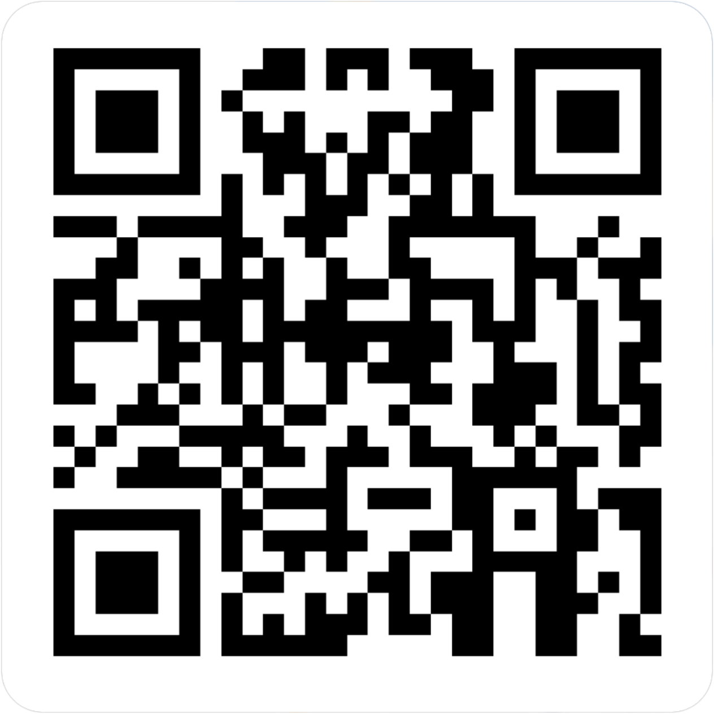
CENTERSTONE SCHOOL-BASED CLINICAL TRAINING SERIES
Prevention Pathways Overview
Completion of this survey is required for attendance verification for today’s training.
https://forms.office.com/r/EXVCQtPbti

